Slide 1
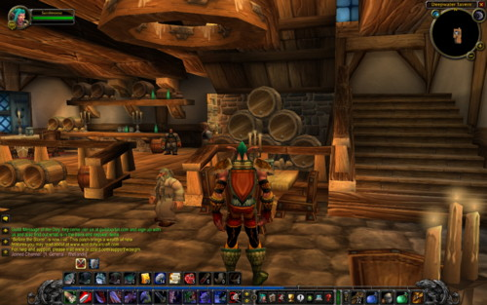
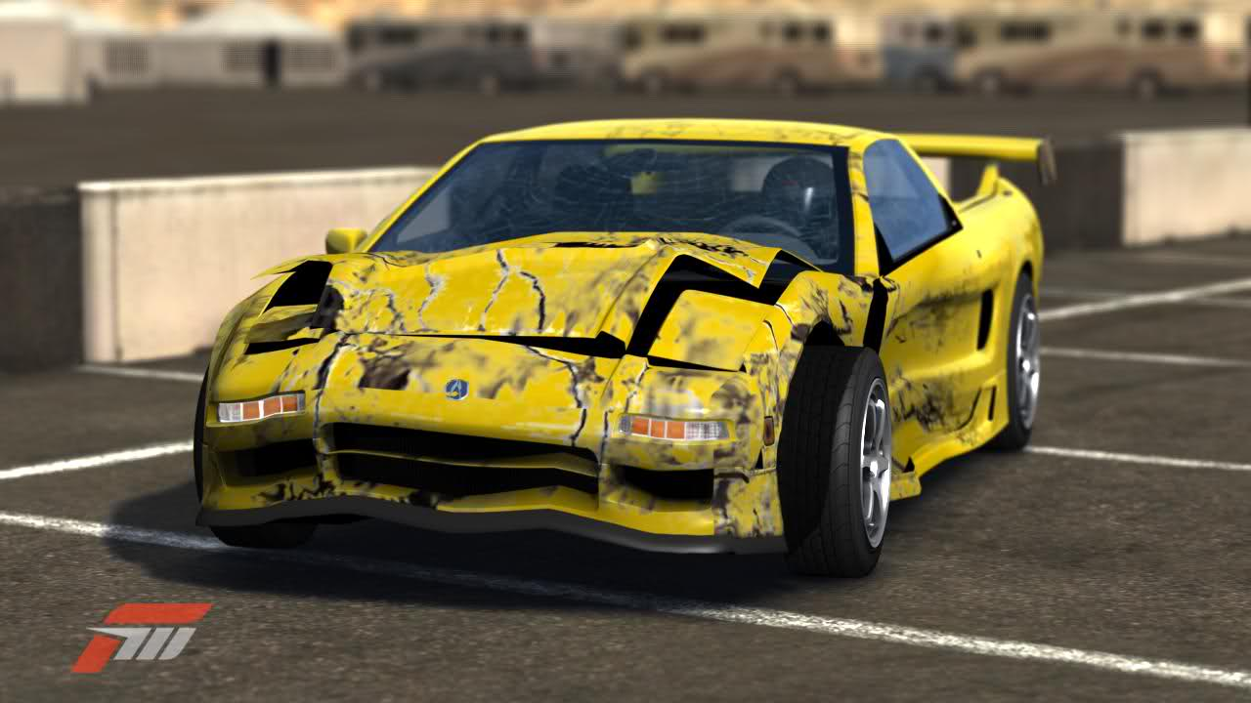


Improving the Player Experience
by Mining Game Data
Thomas Debeauvais – tdebeauv@uci.edu
Notes:
Play games? Which ones?
Outline: quick overview of my work. Then dig down on Forza: goals of study, methods, and findings.

Slide 2

Why Play on a Private Server?
Notes:
Context: RO launched in 2002. Hundreds of illegal private servers. 2010 study.
Methods: Participant observation for a month, 9 semi-structured interviews on official and pserv, affinity diagram with player quotes.
Results: identified mechanics enjoyed/hated by players on each side. Tighter/friendlier community on small pservs.

Slide 3

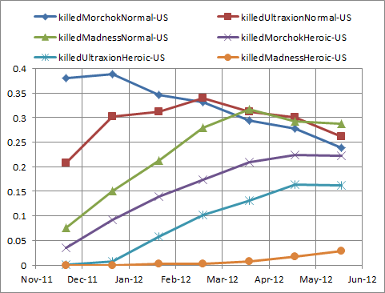
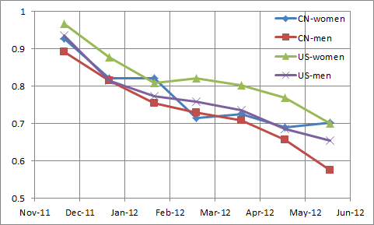
How Fast is Content Consumed?
Notes:
Context: WoW launched in 2004. Longitudinal study in 2012.
Methods: Nick Yee at PARC ran online survey in US and China + crawled player data. I mined in SQL and plotted results.
Results: Content lifespan is 6-7 months (but releases every 9-10 …). Chinese play more intensely than Americans.

Slide 4
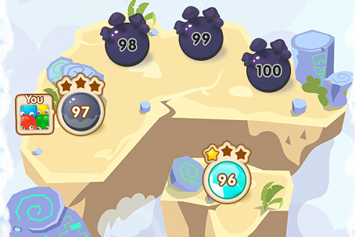
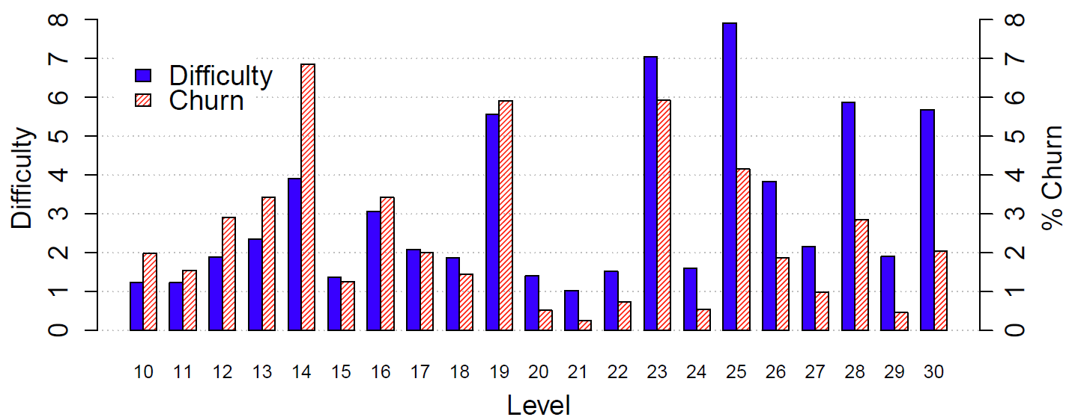
Are Churn and Difficulty Related?
Notes:
Context: JS launched in 2013.
Methods: Wooga shared with me a random 5% of all iOS players from the 10 weeks after launch.
Results: summary bar plot spikes coincide (spearman pcor of .7, controlling for level number).

Slide 5
How do Players Tune Their Assists?
Notes:
Outline for rest of the talk: describe assists, bundles, questions, findings
Tom Z: mentor at MSR, brainstormed research questions, gave feedback.
Developer is Turn 10. They collect and ETL the data.
I pulled it from their DB, cleaned it up, analyzed the data, pitched recommendations to devs

Slide 6
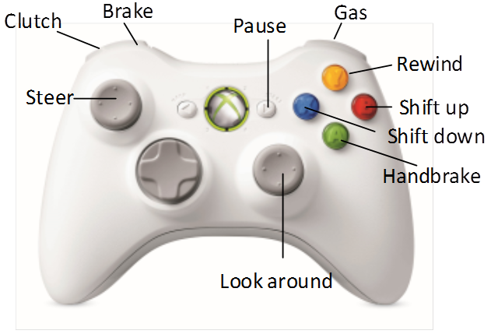
Notes:
Real-life assist: automatic gear = no clutch or gear shifting!
Also in F4 with 3 values: fully auto, manual without clutch, or manual with clutch

Slide 7
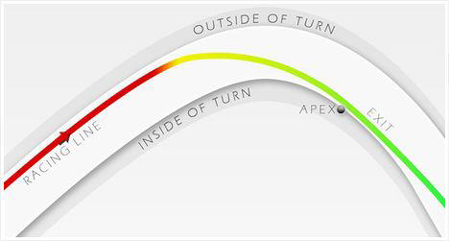
Braking Assist
Notes:
Player’s car automatically brakes in the red

Slide 8
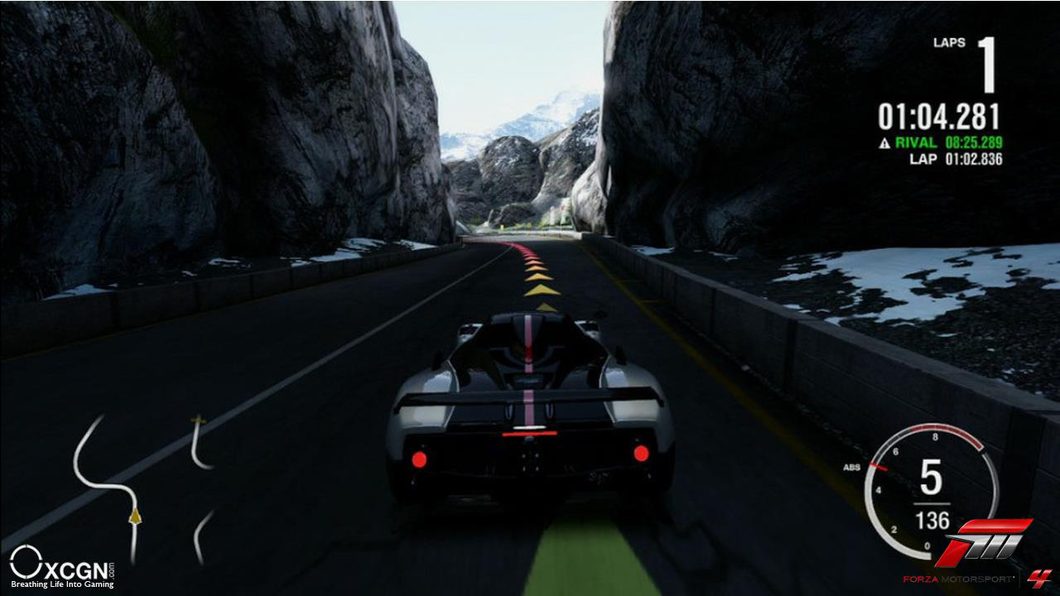
Trajectory Line Assist
Notes:
3 levels: full, brake, or off

Slide 9
 | Easy | Medium | Hard | Advanced | Expert
Line | Full |  | Brake |  | OFF
Notes:
Players can configure at 2 granularities: bundle or assist

Slide 10
 | Easy | Medium | Hard | Advanced | Expert
Line | Full |  | Brake |  | OFF
Stability | ON |  | OFF
Traction | ON |  |  | OFF
Braking | Assisted w/ ABS |  | ABS | OFF
Gear Shifting | Automatic w/o clutch |  |  | Manual w/o clutch | Manual w/ clutch
Damage | Cosmetic | Limited |  | Simulation

Slide 11
Questions
Do players change their assists?
At which granularity: assist or bundle?
Are the bundles adequate?
Which assists change together?
Are all assists equally useful/used?

Slide 12
Telemetry Data
200k players (random 5%)
24M race entries
October 2011 (launch) – July 2013
Focus on career and online modes
Notes:
Explain process: SQL, python clean-up, play game
50% races in career mode, 30% online, 15% quick race, 5% rivals -> focus on career and online modes

Slide 13
Telemetry Data
Ternary assists -> binary assists
 | Easy | Medium | Hard | Advanced | Expert
Line | Full |  | Brake |  | OFF
Full Line | ON |  | OFF
Brake Line | ON |  |  |  | OFF

Slide 14
Example SQL Result
Full Line | Brake Line | Traction | … | # Players | # Races
0 | 0 | 0 | … | 5236 | 16148
0 | 0 | 1 | … | 8423 | 90284
0 | 1 | 0 | … | 124 | 6712
0 | 1 | 1 | … | 5 | 905
… | … | … | … | … | …
Notes:
First approach: aggregate bundle usage – SQL group by on all races
Select full line, brake line, …, count (distinct player id), count(distinct race id)
From races
Where mode = career / online
Group by full line, brake line, …

Slide 15
Bundle | % Career players | % Career races
Easy (default) | 58 | 19
Stability, traction, clutch, cosmetic damage | 28 | 2
Stability, traction, clutch | 21 | 2
Stability, traction, clutch, limited damage | 14 | 1
Medium | 11 | 3
Notes:
Bundles with 10%+ players in career mode
% players does not sum to 100% because players can switch bundle/assists
No over-concluding on Easy – it’s the default. ~20% of players drop out before 10 races, most never change their easy bundle

Slide 16
Bundle | % Career players | % Career races | % Online players | % Online races
Easy (default) | 58 | 19 | 30 | 3
Stability, traction, clutch, cosmetic damage | 28 | 2 | 50 | 5
Stability, traction, clutch | 21 | 2 | 13 | 1
Stability, traction, clutch, limited damage | 14 | 1 | 4 | 1
Medium | 11 | 3 | 1 | 0
Clutch and cosmetic damage | 1 | 1 | 32 | 20
All but autobrake | 8 | 4 | 13 | 3
All but autobrake and full line | 4 | 3 | 10 | 3
Notes:
Take-aways: 1) easy (default) bundle popular, 2) medium meh, 3) STC go together, 4) all but autobrake popular online

Slide 17
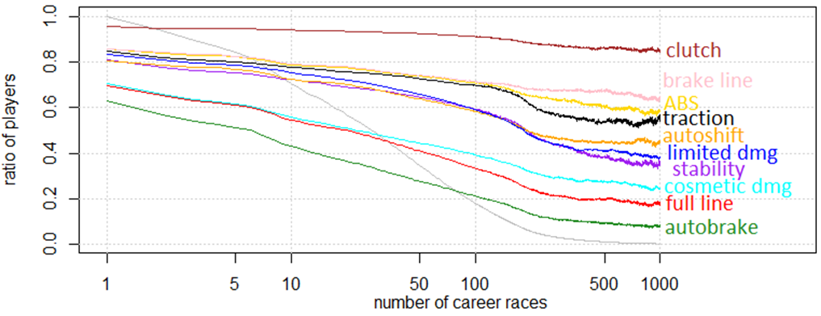
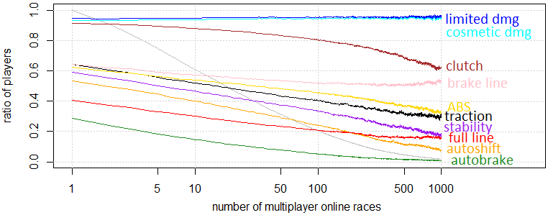
Notes:
Gray: ratio of player base reaching that many races
Colors: ratio of players who use the assist over time
Take-aways: 1) full line + autobrake = easiest, 2) brake line + ABS + traction go together, 3) stability + autoshift go together, 4) damage should be ON/OFF

Slide 18
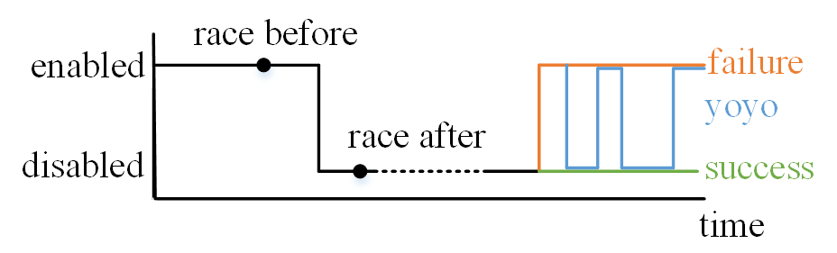
Are All Assists Equal?

Slide 19
 | Easy | Medium | Hard | Advanced | Expert
Line | Full | Brake |  | OFF
Stability | ON |  | OFF
Traction | ON |  |  | OFF
Braking | Assisted w/ ABS | ABS |  | OFF
Gear Shifting | Automatic w/o clutch |  | Manual w/o clutch |  | Manual w/ clutch
Damage | Cosmetic |  | Simulation
Notes:
Recommendations

Slide 20
Super Easy
 | Easy | Medium | Hard | Advanced | Expert
Line | Full | Brake |  |  | OFF
Stability | ON |  | OFF
Traction | ON |  |  | OFF
Braking | Assisted w/ ABS | ABS |  |  | OFF
Gear Shifting | Automatic w/o clutch |  |  | Manual w/o clutch | Manual w/ clutch
Damage | Cosmetic |  | Simulation
Notes:
Shipped in FM5. super easy = easy with assisted steering (steering not tracked in logs)
Evaluation: FM5 shipped after my internship, so I don’t know if players used these bundles more or not.

Slide 21
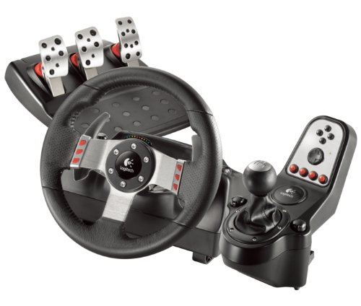
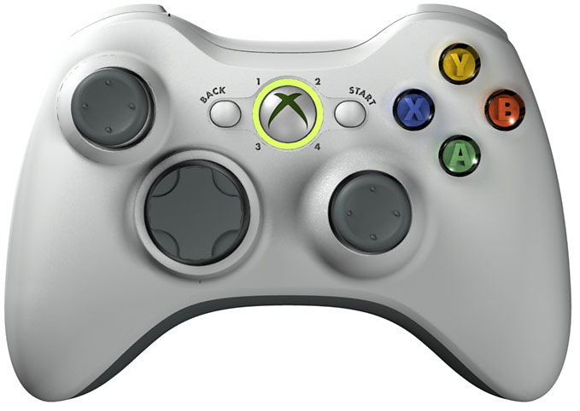
Wishes - Controller
Notes:
Telemetry should log controller type

Slide 22
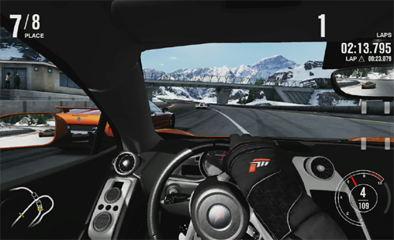
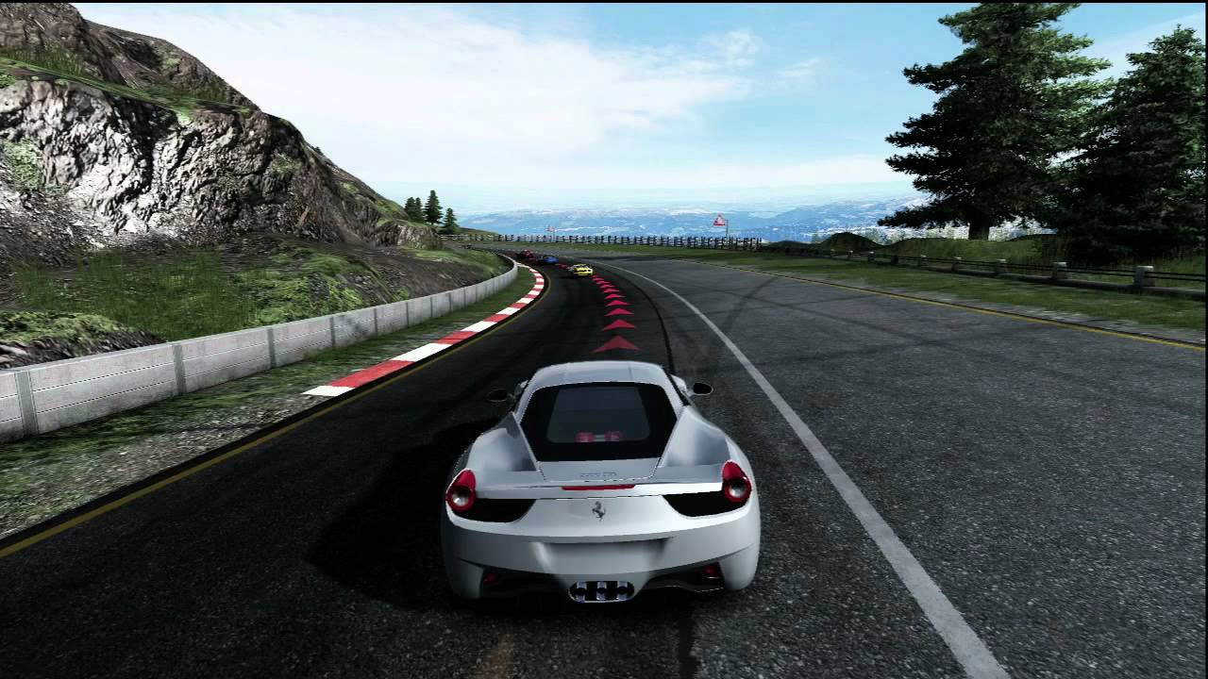
Wishes - View
Notes:
Telemetry should also log the view

Slide 23

Discussion

Slide 24
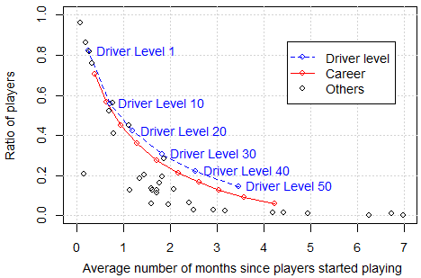

Slide 25
 | Log OR | Explanation
Position at finish line | + | Confidence?
Car performance index | – | “Stacking handicaps” Sedan first, F1 right after
Number of races | – | Habit?

Slide 26
 | Precision | Recall
Autobrake | 84% | 97%
Full line | 78% | 95%
Clutch | - | -
Others | 60-70% | 50-80%

Slide 27
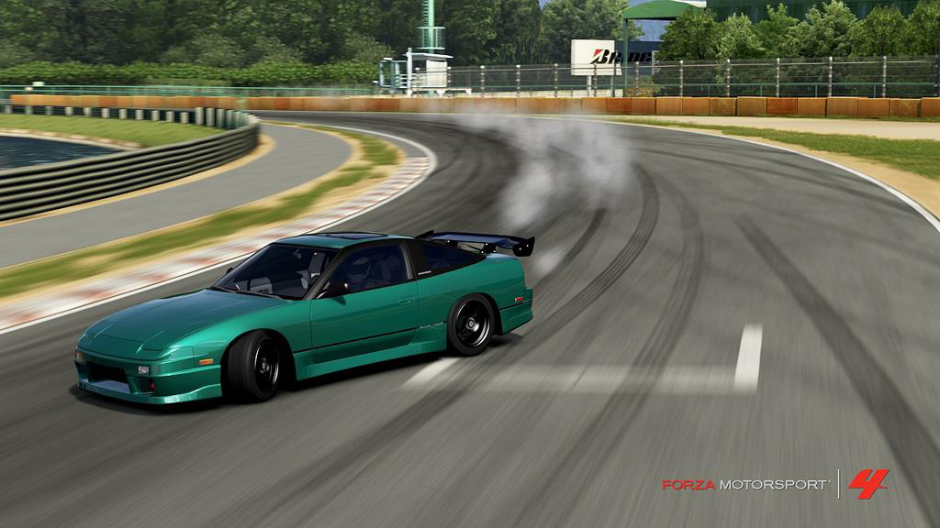
Stability Assist

